Slide 1
Startup Profit Analysis
Internship Project June-2026
PRDA-01-Profit Analysis
Submitted By: Varun Vinay Gokral
Tools Used: SQL | Power Bi | Python
Dataset Source: MySQL Database(50 Records)

Slide 2
Problem Statement & Project Objective
Problem Statement :Startup companies invest in Research & Development, Administration, and Marketing to improve their business performance. Understanding how these expenditures influence profit helps businesses make informed financial and strategic decisions.
Project Objective :The objective of this project is to analyze startup expenditure data and predict profit using Linear Regression. The project also aims to visualize business insights through an interactive Power BI dashboard.
Dataset Overview:
Dataset: Startup Profit Analysis
Source : MySQL Database
Total Records: 50 Startups
Features: R&D Spend, Administration, Marketing Spend, State, and Profit
Tools Used: MySQL ,Python (Pandas, Scikit-learn) ,Power BI

Slide 3
Data Collection & Preprocessing
Data Collection:
Connected to the MySQL database using the provided credentials.
Retrieved the startup dataset from the startup table.
Imported the data into Python (Jupyter Notebook) for analysis.
Data Preprocessing:
Loaded the dataset using the Pandas library.
Verified the dataset using "head()", "info()", and "describe()"
Checked for missing values and duplicate records.
Converted the categorical State column into numerical dummy variables using One-Hot Encoding.
Split the dataset into training (80%) and testing (20%) sets for model development.
Data Quality:
Total Records: 50- Missing Values: 0
Duplicate Records: 0
Data Types: Verified and suitable for analysis.

Slide 4
Linear Regression Analysis
Model Development
The startup dataset was analyzed using the Linear Regression algorithm to predict profit based on the following independent variables:
R&D Spend
Administration
Marketing Spend
State (One-Hot Encoded)
The dataset was divided into:
Training Data: 80%
Testing Data: 20%
Model Evaluation
The performance of the regression model was evaluated using:
Mean Absolute Error (MAE)
Mean Squared Error (MSE)
R² Score

Slide 5
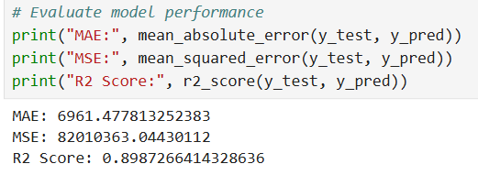
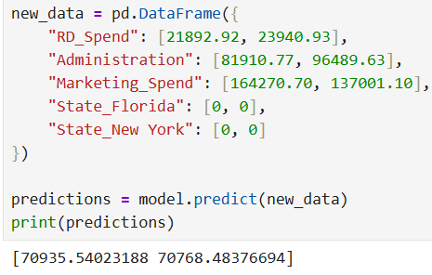
Regression Results & Profit Prediction
Model Performance
The Linear Regression model was evaluated using standard regression metrics.
Evaluation Results
Mean Absolute Error (MAE): 6961.48
Mean Squared Error (MSE): 82,010,363.04
R² Score: 0.899
The model achieved an R² Score of approximately 0.90, indicating that it explains about 90% of the variation in startup profit. This demonstrates that the model has good predictive performance.
Profit Prediction
The trained model was used to predict the profit for the two startup expenditure records provided in the assignment.
Predicted Profits
Startup 1: 70,935.54
Startup 2: 70,768.48
These predicted values were generated using the trained Linear Regression model based on R&D Spend, Administration Spend, Marketing Spend, and State.

Slide 6
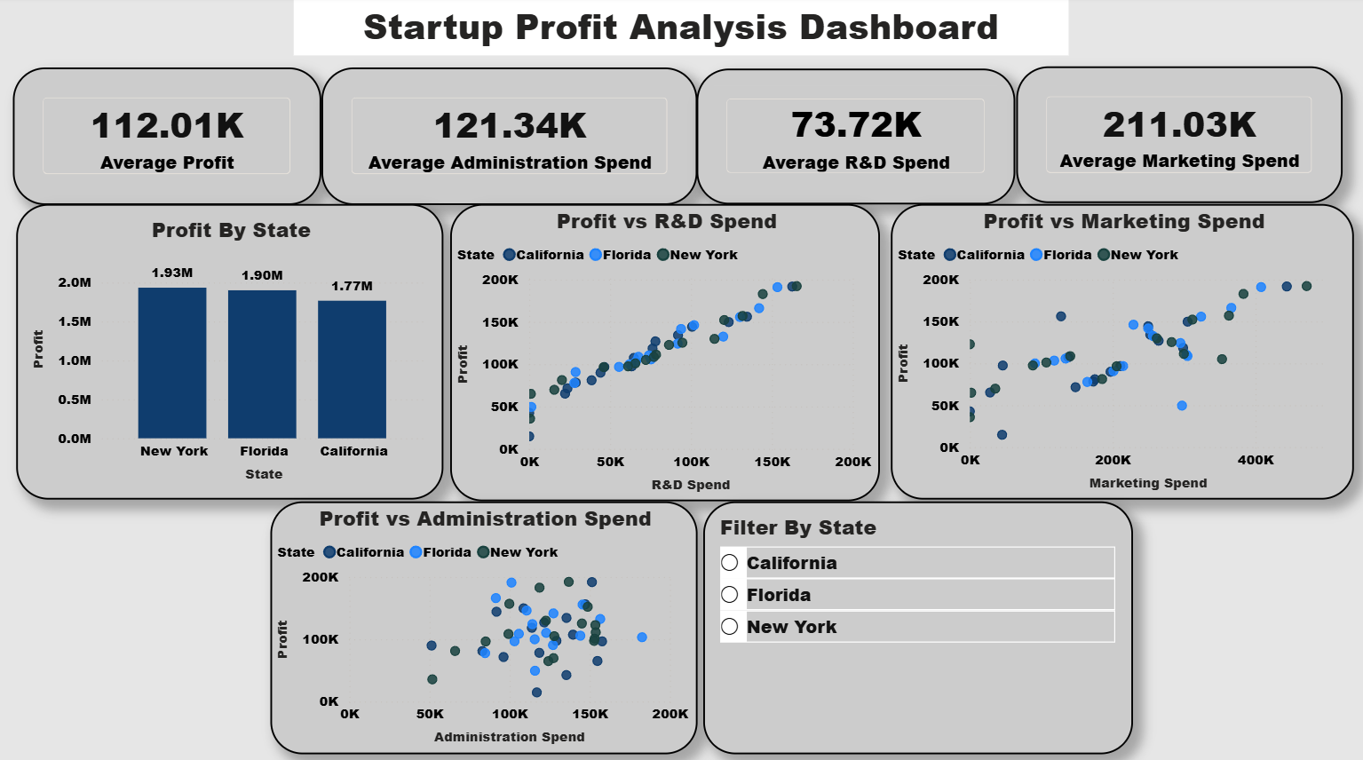

Slide 7
Dashboard Insights & Recommendations
Key Insights
The average profit across all startups is 112.01K.
The average expenditure on Marketing (211.03K) is the highest, followed by Administration (121.34K) and R&D (73.72K).
New York records the highest total profit, followed closely by Florida, while California has the lowest total profit among the three states.
There is a strong positive relationship between R&D Spend and Profit, indicating that startups investing more in research and development generally earn higher profits.
Marketing Spend also shows a positive relationship with profit, although the correlation is weaker than R&D spending.
Administration Spend has the weakest relationship with profit, suggesting that higher administrative expenses alone do not significantly increase profitability.
Recommendations
Increase investment in Research & Development to improve profitability.
Maintain an effective marketing strategy while controlling unnecessary marketing expenses.
Optimize administration costs to improve operational efficiency.
Use data-driven analysis to support investment and business decisions.

Slide 8
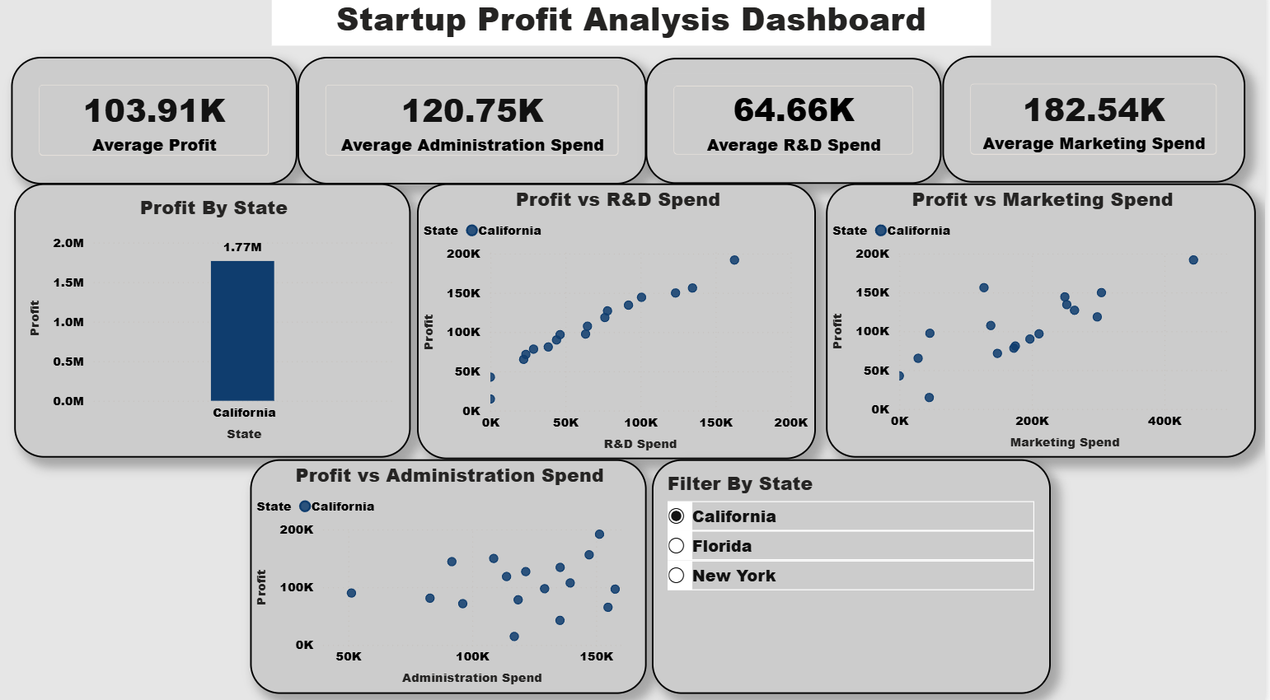
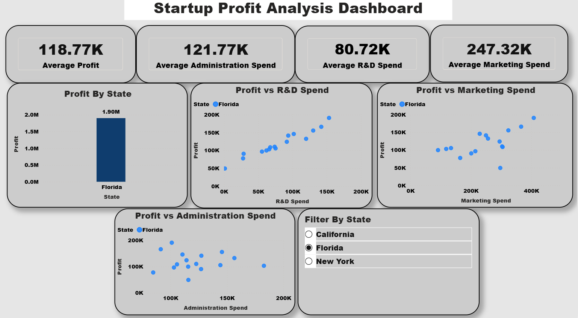
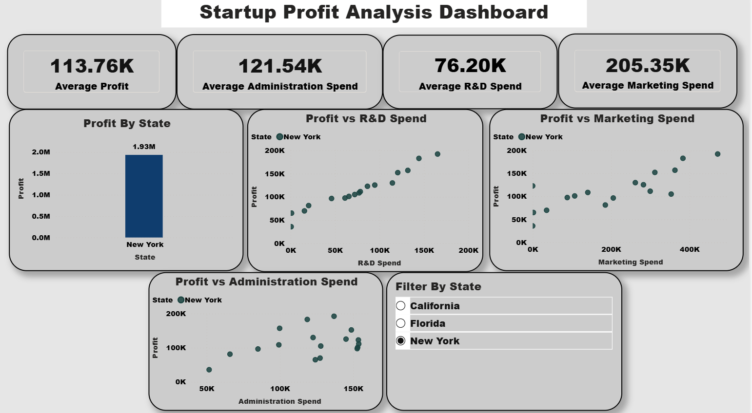
State-wise Dashboard
California
Lowest average profit among the three states.
Lower R&D and Marketing spending compared to other states.
Profit increases as R&D spending increases.
Florida
Highest average profit.
Highest investment in R&D and Marketing.
Strong positive relationship between R&D spending and profit.
New York
Average profit is slightly lower than Florida.
Balanced spending across all departments.
Consistent profit growth with increasing R&D investment.

Slide 9
Overall Conclusion
The startup profit dataset was successfully analyzed using Linear Regression and Power BI.
The regression model achieved an R² Score of 0.899, indicating good prediction accuracy.
R&D Spend has the strongest positive impact on profit.
Marketing Spend also contributes to higher profits, while Administration Spend has the least impact.
Florida recorded the highest average profit, followed by New York, while California had the lowest average profit.
The interactive Power BI dashboard enables quick analysis of spending patterns and profitability across states

